Slide 1
Lecture 17
Nick Rugai PhD

Slide 2
Classes and Methods Ch. 17
Classes can have an Operator Overloading.
Overloading makes ‘special’ methods calls at the moment an instance is made.
__init__ is the Constructor Method.
A method is a function associated with a class.

Slide 3
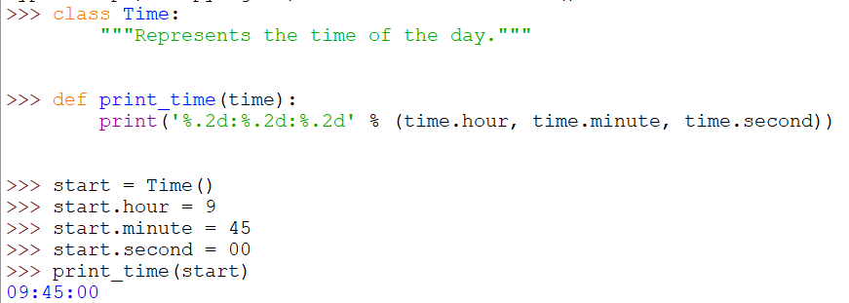
Classes and Methods
print_time is a function that lives outside the class

Slide 4
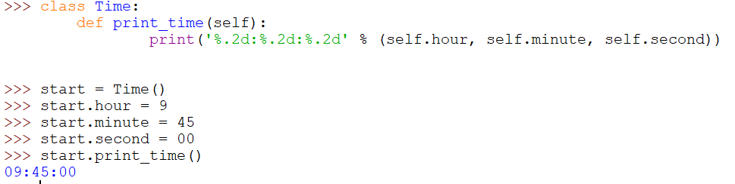
Classes and Methods
This print_time is a method that lives inside the class

Slide 5
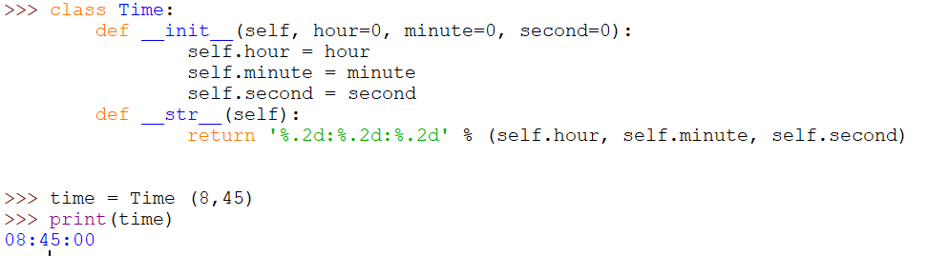
Classes and Methods
__init__ is not the only overloading operator method.
__str__ is used by Python in conjunction with the print statement.

Slide 6
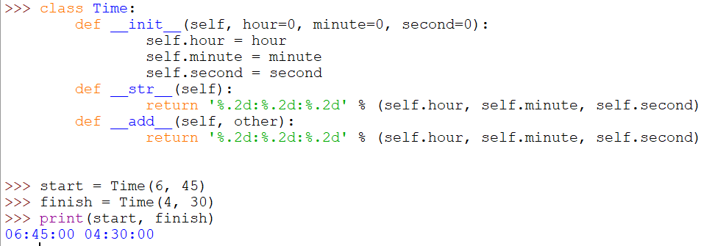
Classes and Methods
__add__ lets the overloading of two instances:

Slide 7
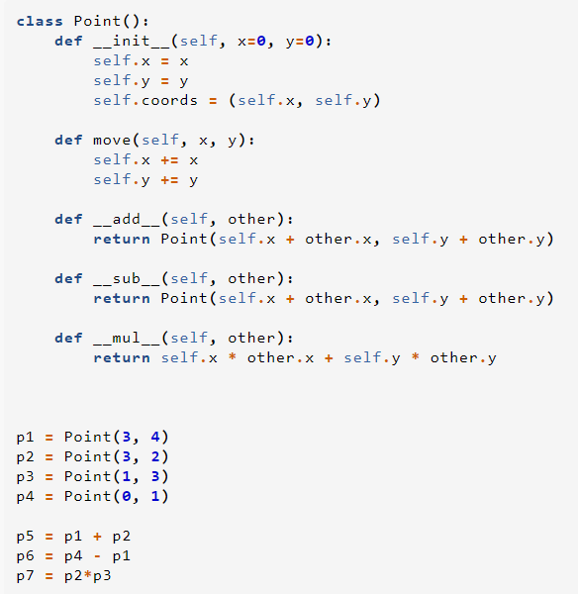
Classes and Methods
There are many overloading methods.

Slide 8
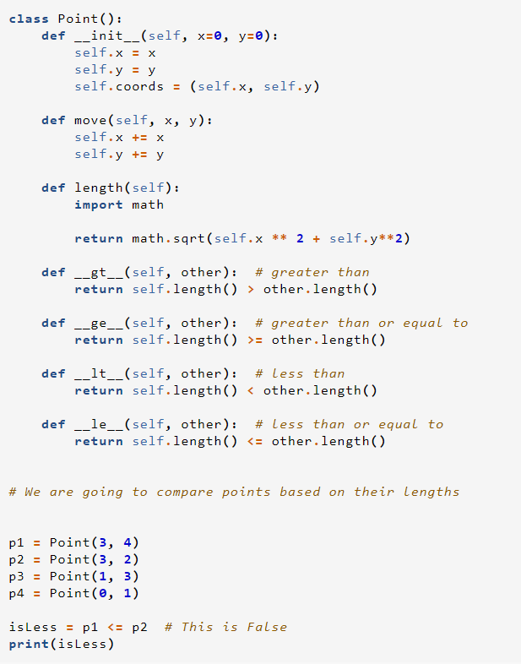
Classes and Methods
There are many overloading methods.

Slide 9
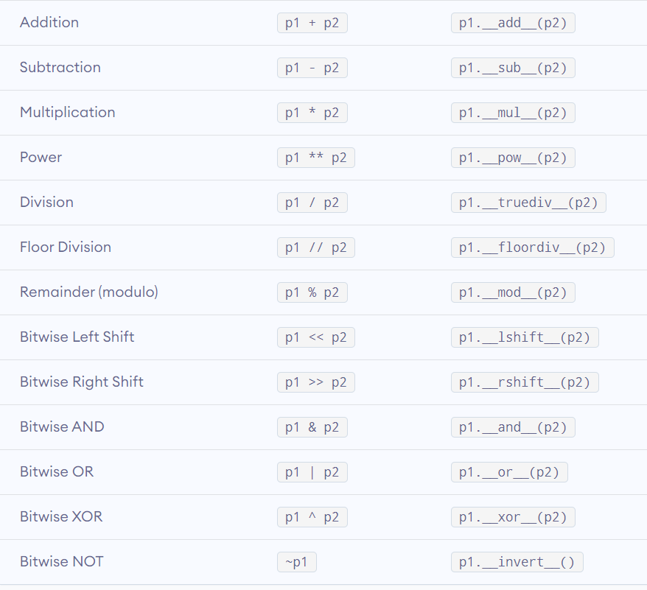
Classes and Methods

Slide 10
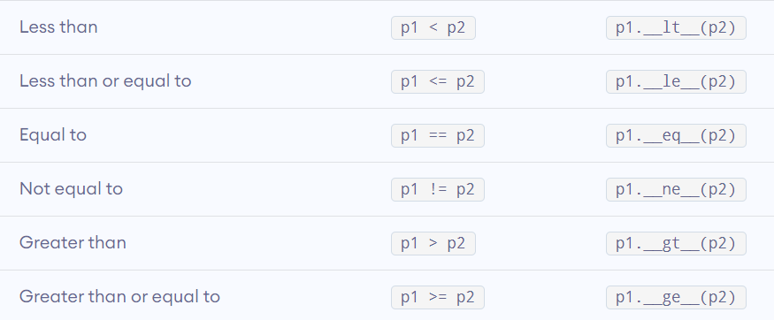
Classes and Methods

